Slide 1
How do we realize the RoI on MBSE?
Tom McDermott, CTO
Systems Engineering Research Center
Notes:
This slide with all of the collaborators provides an important point about the expanse of the research.
Slide #6 lists all of the researcher that have contributed to this overall effort.

Slide 2
As-Is Engineering - Document Intensive with Disciplinary Stovepipes
A validated need/opportunity/mission shortfall
Functional Modeling and Analysis
Security Modeling and Analysis
Safety Modeling and Analysis
Reliability Modeling and Analysis
Performance Modeling and Analysis
Requirements/Parameters/Constraints
All the Modeling and Analysis is done by different groups within an organization.
Chief Engineer/Systems Engineer has to:
Communicate
Translate
Facilitate data flow
Requirements/Parameters/ Constraints
Design/Insights
Requirements/Parameters/Constraints
Design/Insights
Requirements/Parameters/Constraints
Design/Insights
Requirements/Parameters/Constraints
Design/Insights
Design/Insights
Notes:
This slide is reflective of the situation describe by ARDEC SMEs during RT-168. They use some 80 tools, some overlapping in capabilities which are preferred by different tool users.
Example: Only of Discipline-Specific Analysis Workflow – Needs to be Done At All Levels of Abstraction

Slide 3
Complex – Technically & Organizationally
100s to 1000s of development team members;
Across multiple organizations
Each discipline has its own tribal language;
Cultures vary across organizations; disciplines and domains;
Each discipline has its own set of tools that they use and trust;
Analysis and decision making in each domain/disciplines can impact the effort in other domains.
Geometry & Packaging
Airframe & Engine
Aero
Store/ Payloads
Sensors
Vehicle Design
“illites”
Propulsion
Structures
Comm./ Radar

Slide 4
Opportunities to Refactor and Improve the As-Is Analysis & Design Process
Homegrown/Empirical/Parametric Tools – used over time and trusted by the difference disciplinary and domain communities
Lack of Tool Interoperability – these tools have varying ontologies and lexicon and units, and require experienced SMEs for operation
Tool Methodologies – these tools often have varying assumptions and inconsistent and asynchronous model/tool updates
Tool Input and Output Coordination – given the lack of interoperability between tools, coordinating an end to end analysis is disjoint, time consuming and labor intensive
Tool-related Human Factors – given that these tools are often home grown and developed/evolved over time, with minimal documentation, significant investment of time necessary for developing SMEs – hard for non-SMEs to use.
This is an aspect of design – synthesis, analysis, and decision making that adds to design delays, design rework – issues that Systems Engineers have to personally and manually address in the current context.

Slide 5
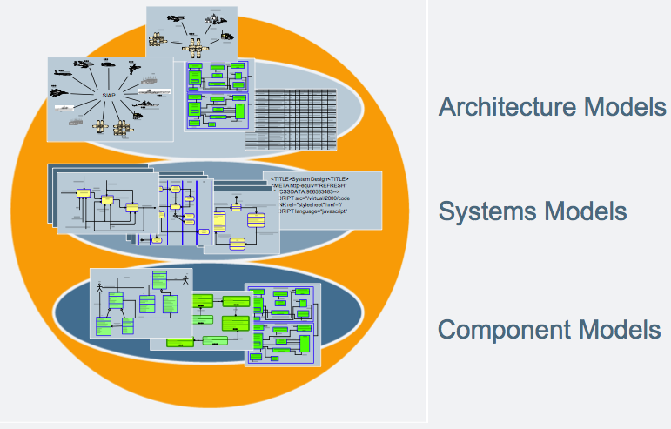
Need to Better Integrate Multiple Levels of System Models/Designs with Discipline-Specific Designs
Architectural, System and Component Models Define Cross-Domain Relationships but Integration of Detailed Behaviors is limited or challenging
manage
Geometry & Packaging
Airframe & Engine
Aero
Store/ Payloads
Sensors
Vehicle Design
“illites”
communicate
Propulsion
Iterative Process
Structures
Comm./ Radar

Slide 6
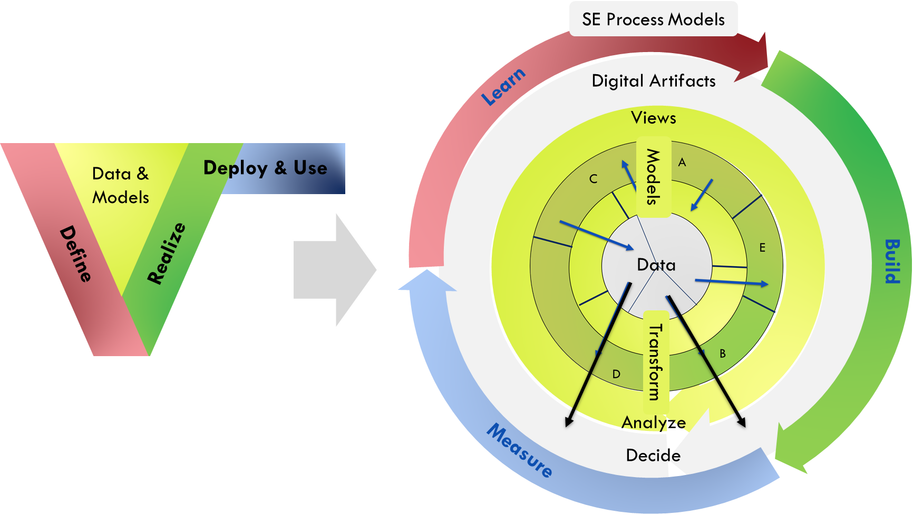
Revised Mental Model of Systems Engineering
Digital Engineering refactors the Learn-> Build->Measure (or Define->Realize-> Deploy & Use) stages of a development program in a circular process to represent it as:
1) data transformations at the core 2) layered across disciplines & tasks 3) continuous processes that could be entered from any point

Slide 7
Digital Engineering Infrastructure: Reference Architecture
Cost Models and Simulation
Advanced Data
Exploitation & Analysis
(AI, Data Analytics, Machine
Learning, MDAO…)
Campaign
Mission Models & Simulation & Concept of Operations
Capability-Based T&E (Live, Virtual Constructive)
Mission
Engagement
System Models (Req’s, I/F’s, Behavior, Structure, Dynamic) Descriptive/Analytic
System V&V Models, (Performance, HSI, Safety, R&M, Logistics, Security, Risk, etc.)
Systems Engineering
and Design
Semantically Rich Interface Exchange to Authoritative Source
Knowledge Management Resources (method, process, reference models, CM, etc.)
Manufacturing Models and Simulation
Operations, Sustainment, and Training Models
Virtual Products: Digital Threads & Twins
Component Models (Discipline-specific) for both Analytical & Design
Product Lifecycle Models
Component V&V Models, (Performance, Materials, R&M, Environment, etc.)
Multi-physics (CFD, FEA, 6DOF)

Slide 8
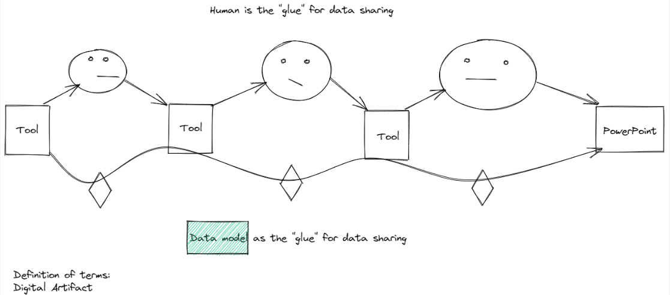
The RoI: Aiding the Human Decision Processes
Today this is a “Bunch of soda straws”
We aspire to a fully integrated workflow
Digital Artifact - An artifact produced within, or generated from, the engineering ecosystem. These artifacts are generated through transformation of data and models into views in order to visualize, communicate, and deliver data, information, and knowledge to stakeholders.

Slide 9
The Purpose and Value of Digital Engineering
Improved interoperability & connectivity of data and models
Easier to drill down: decision to data
A process that is more seamless and efficient

Slide 10
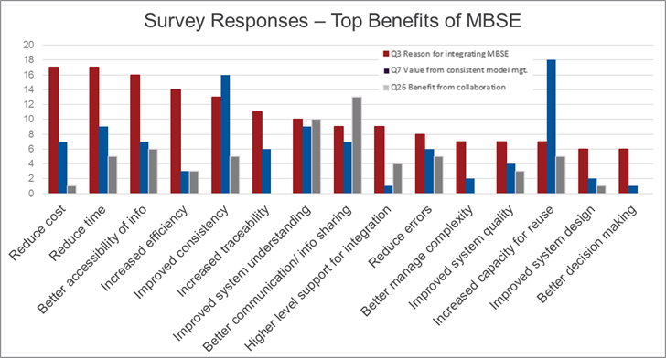
Top-cited Benefits from our Survey
https://sercuarc.org/results-of-the-serc-incose-ndia-mbse-maturity-survey-are-in/

Slide 11
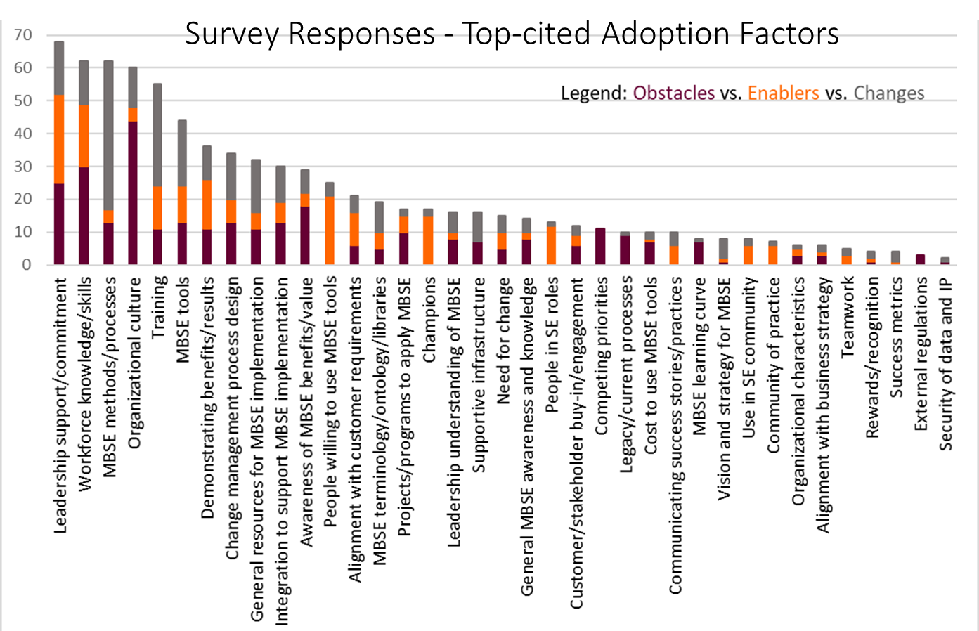
Organizational Adoption: Survey Results
Organizational design | Organizational Enablers/Barriers | Organizational Change Management
Workforce knowledge / skills | Leadership support & commitment | DE/MBSE methods /process (maturity)
Integration (tool infrastructure) | Training & roles | Change management process design
Demonstrated benefits / results | Resources for implementation | Organizational culture (overcoming resistance)
Awareness of benefits / results | Tools: User experience & stakeholder buy-in | People willing to use the DE/MBSE tools

Slide 12
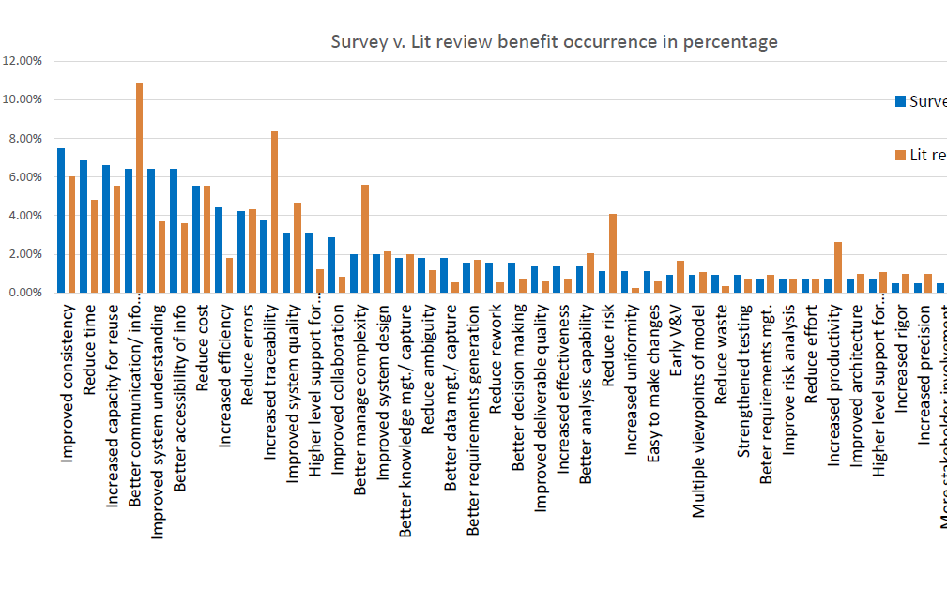
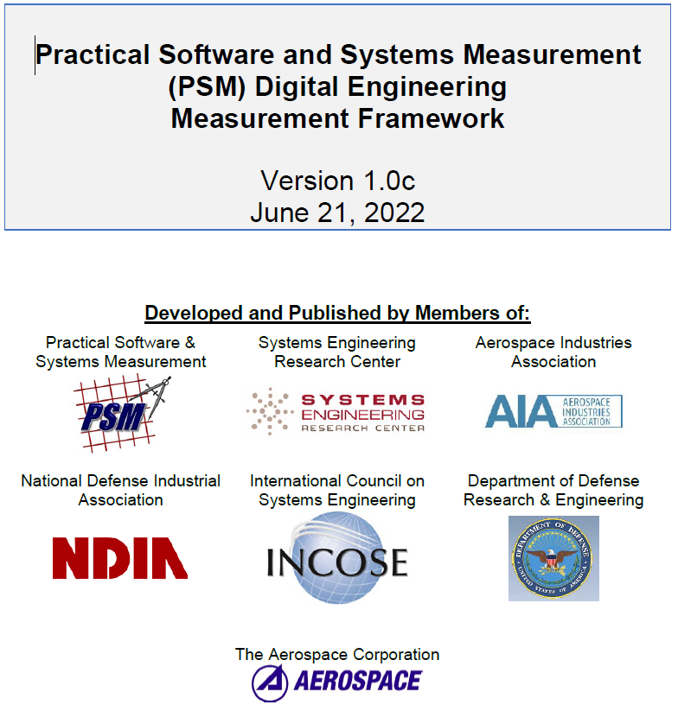
Measurement: Survey Results
http://www.psmsc.com/DEMeasurement.asp

Slide 13
Putting this Research into Practice
Focus on the two primary measurable values of DE and MBSE:
models that provide holistic insight to and CM of the end product behavior and performance
the digital connectivity to data and analysis models that improve the efficiency of the development, management, and support teams
Really talented systems modelers are needed to create models that involve and lead the team to make faster and better decisions
Really good software/information technology people are needed who transparently improve the team’s efficiency through the digital connectivity
Must measure the data/model lifecycle
Must have understanding of the factors that need to be addressed for successful adoption of the digital and MBSE methods and tools
Must have the organizational leadership and change management support.

