Slide 1
Fulbright Faculty Award
Opportunities
Christopher Lukasik
clukasik@purdue.edu
Provost Fellow for Fulbright Faculty Awards
Purdue University
March 22, 2024

Slide 2
Fulbright Scholar Program
Fulbright Specialist Program

Slide 3
Fulbright Scholar Award Program
1. Fulbright Scholar Award Program AY 2025-26
• More than 400 research, teaching, research/teaching awards in over 100 countries; including over 170 All Discipline awards. See https://awards.cies.org
• The Fulbright Scholar Award is the only award on the Provost’s list of prestigious awards to which clinical and tenure-stream faculty from every unit on campus can apply. Administrators and faculty with industry backgrounds are also eligible.
• Full catalogue of awards announced around Feb. 2024 with an online application deadline of Sep. 16, 2024
• Awards range from 2 to 12 months
• To be eligible, faculty must be a US citizen
• All ranks of faculty are eligible to apply, but only tenure-line and clinical faculty are eligible for salary top-offs at Purdue.
• Recent Awardee: Paul Asunda, Associate Professor of Technology Leadership and Innovation, Teaching/Research Award to Masinde Muliro University of Science and Technology [MMUST], Kenya for “Building Identities and Persistence in STEM Learning Through Engineering Design Practices ” (2023-24).

Slide 4
Sample Fulbright Scholar Awards: Engineering
Award Title | Country | Activity
Fulbright Scholar Award in Resources and Energy (Curtin University) | Australia | Research
Fulbright Iceland-National Science Foundation Artic Research Grants | Iceland | Research
Fulbright Award in Space, Atmosphere, Ocean, Climate, Energy and Data Sciece / AIR Centre | Portugal | Research, Professional Project
Fulbright-VTT Award in Science, Technology, and Innovation | Finland | Research
Fulbright Early Career Research Lectureship at the Department of Civil, Environmental, and Mechanical Engineering at the University of Trento | Italy | Teaching/Research
Mechanical Engineering at the Universidad de Vigo (Centro Universitario de la Defensa) | Spain | Teaching/Research

Slide 5
Fulbright Scholar Award Timeline
Successful applicants typically work two years backwards from the AY they plan on arriving in the host country. If you plan to be in Spain in Fall 2025, the process should begin now. But it’s never too late to start!
1
2
3
4
5
What do you want to do and where do you want to go?
Identify 1 award, contact host institution, refine project, and notify Unit Head and Provost’s Office
Apply
Peer Review and Selection
2 years prior
Fall 2023
2 years prior
Spring 2024
1 year prior
Sept. 15, 2024
1 year prior
Fall 2024 / Spring 2025
AY of Grant
2025-2026

Slide 6
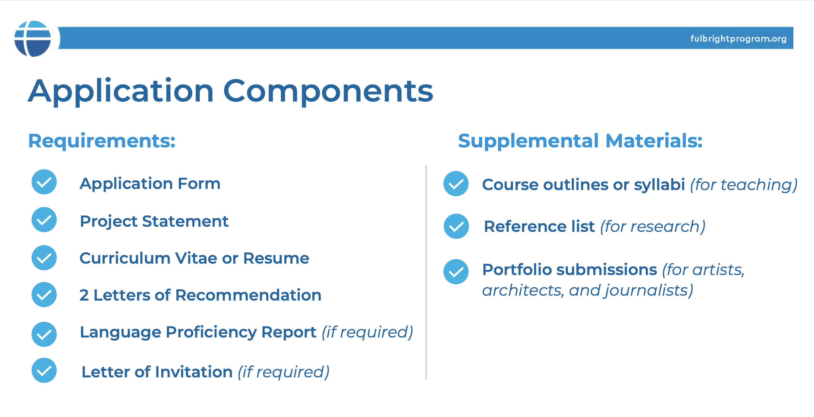
Fulbright Scholar Award Application

Slide 7
What’s New in AY 2025-26?
1. Fulbright Scholar Award Program AY 2025-26
• New award comparison tool on the Fulbright Scholar Award website, which allows you to compare up to 3 awards across multiple categories at the same time.
• New Fulbright International Education Administrator (IEA) Awards. Higher education administrators participate in seminars to learn about a country's higher education system and context.
• Many new awards in Europe, including a new awards in France, Malta, and Norway. And new Distinguished Scholar awards in Chile and Brazil.
• A general de-emphasis on Letters of Invitation during the review process.

Slide 8
Fulbright Scholar Awards
Percentage of Purdue faculty applicants who won Fulbright Scholar awards for the past 5 years.
50.7%
Purdue has been named a “Top Producing Fulbright Institution” by Fulbright National the last three years in a row.

Slide 9
Fulbright Specialist Program

Slide 10
Fulbright Specialist Program
2. Fulbright Specialist Program
• Program pairs highly qualified U.S. academics with host institutions abroad to share their expertise, strengthen institutional linkages, hone their skills, and gain international experience.
• 160 participating countries
• Funded projects are for 14 to 42 days (2-6 weeks)
• 24 Eligible discipline areas, including: Agriculture, American Studies, Anthropology, Archaeology, Biology Education, Business Administration, Chemistry Education, Communication, Computer Science and Information Technology, Economics, Education (very broadly conceived), Engineering Education, Environmental Science, Law, Library Science, Math Education, Peace and Conflict Resolution Studies, Physics Education, Political Science, Public Administration, Public/Global Health, Social Work, and Sociology, and Urban Planning.
• There are no specific awards, just projects which are funded.
• For more information, see https://fulbrightspecialist.worldlearning.org

Slide 11
What Can I Do On a Fulbright Specialist Award?
What kinds of projects are funded?
• Delivering a seminar or workshop
• Consulting on faculty or workforce development
• Developing academic or training curricula and materials
• Lecturing at the graduate or undergraduate level
• Conducting needs assessments or evaluations for a program or institution
What You Cannot Do On A Project
• Teach a course for credit
• Conduct research
What is the application timeline?
1. Faculty member applies to be named to Fulbright Specialist Roster
2. Get project approved by host Institution/Host Country
3. Eligible individuals on the Fulbright Specialist Roster matched to host institution projects
4. Final approval by the J. William Fulbright Foreign Scholarship Board
5. Fulbright Specialist implements project abroad with host institution

Slide 12
Fulbright Specialist Program Benefits
• Costs are shared between Fulbright and host institution, host country education agency. Fulbright supplies roundtrip airfare, local transport to airport, and a stipend for the specialist. Host institution supplies local transport, per diem, and housing for the specialist.

Slide 13
Fulbright Specialist Application Process
Fulbright Specialist Program Application Process
• Faculty apply to be named to the Fulbright Specialist Roster. If selected, they are eligible to be paired with either open projects from host institutions world-wide or with a named project developed by the Specialist with an international colleague and a host institution in advance.
• Faculty can be paired with a Specialist project at a host institution in two ways:
1. Apply to be paired with an open project on the World Learning website. Host institutions need faculty with specific expertise to work on projects throughout the world. In open projects, the cost sharing is already supplied by the host country/host institution.
2. Work with an existing international partner and their host institution to develop a named project and get that project approved and funded by the appropriate host country Fulbright Commission or US Embassy (typically via an online portal).

Slide 14
Fulbright Specialist Application

Slide 15
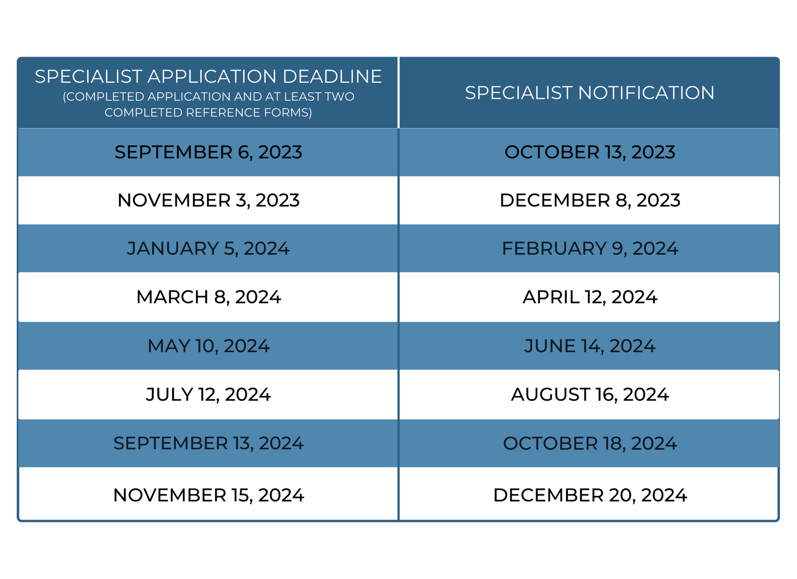
Fulbright Specialist Deadlines 2024
There is a rolling deadline; applications to be named to the Specialist Roster are reviewed several times a year.

Slide 16
How I Can Help
Contact Christopher Lukasik – clukasik@purdue.edu
Provost Fellow, Fulbright Faculty Awards, Purdue University
1. Consult with faculty in selecting the right Fulbright award opportunity, assist in navigating Fulbright’s award programs, or finding host institution/country contacts.
2. Assist faculty through the application process, including access to sample essay questions & project statements from past awardees, sample LOIs, and other helpful materials.
3. Review individual application materials of faculty before the September 16 application deadline and in advance of any Specialist roster deadline.
4. Assist faculty through the pre- and post-award process.

Slide 17
Fulbright Faculty Award
Opportunities
Christopher Lukasik
clukasik@purdue.edu
Provost Fellow for Fulbright Faculty Awards
Purdue University

Slide 18
Fulbright Specialist Application Essays

Slide 19
Benefits of Fulbright Awards
• The Fulbright Scholar Award is the only award on the Provost’s list of 22 “highly prestigious awards” to which clinical and tenure-stream faculty from every unit on campus can apply. It is used by the NRC, AAU, and MUP/TARU for measuring university performance.
• Criteria for Promotion at Purdue University
II. Discovery
A. “…. evidence of national/international visibility … The candidate must offer a substantial record of published original research or its equivalent …. national and/or international reputation.”
III. Teaching and Learning
A. “a record of scholarly teaching and student success-related publications and evidence of national/international visibility”
IV. Engagement
C. “Faculty seeking promotion for engagement activities should provide a record of scholarly engagement-related publications and evidence of national/international visibility.”
Source: Purdue University, Criteria for Promotion, 2019

Slide 20
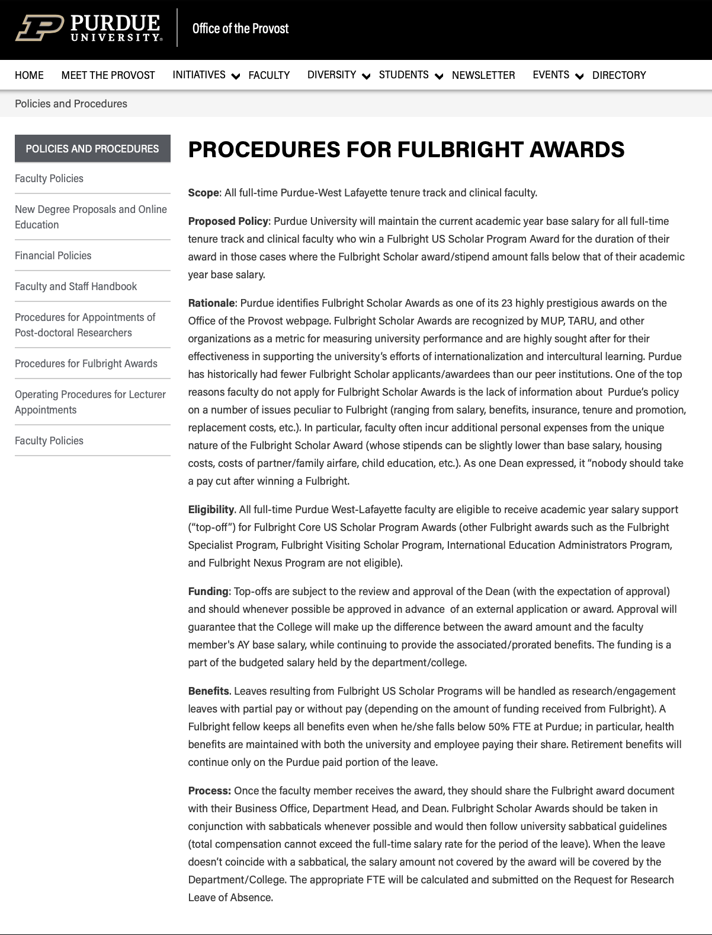
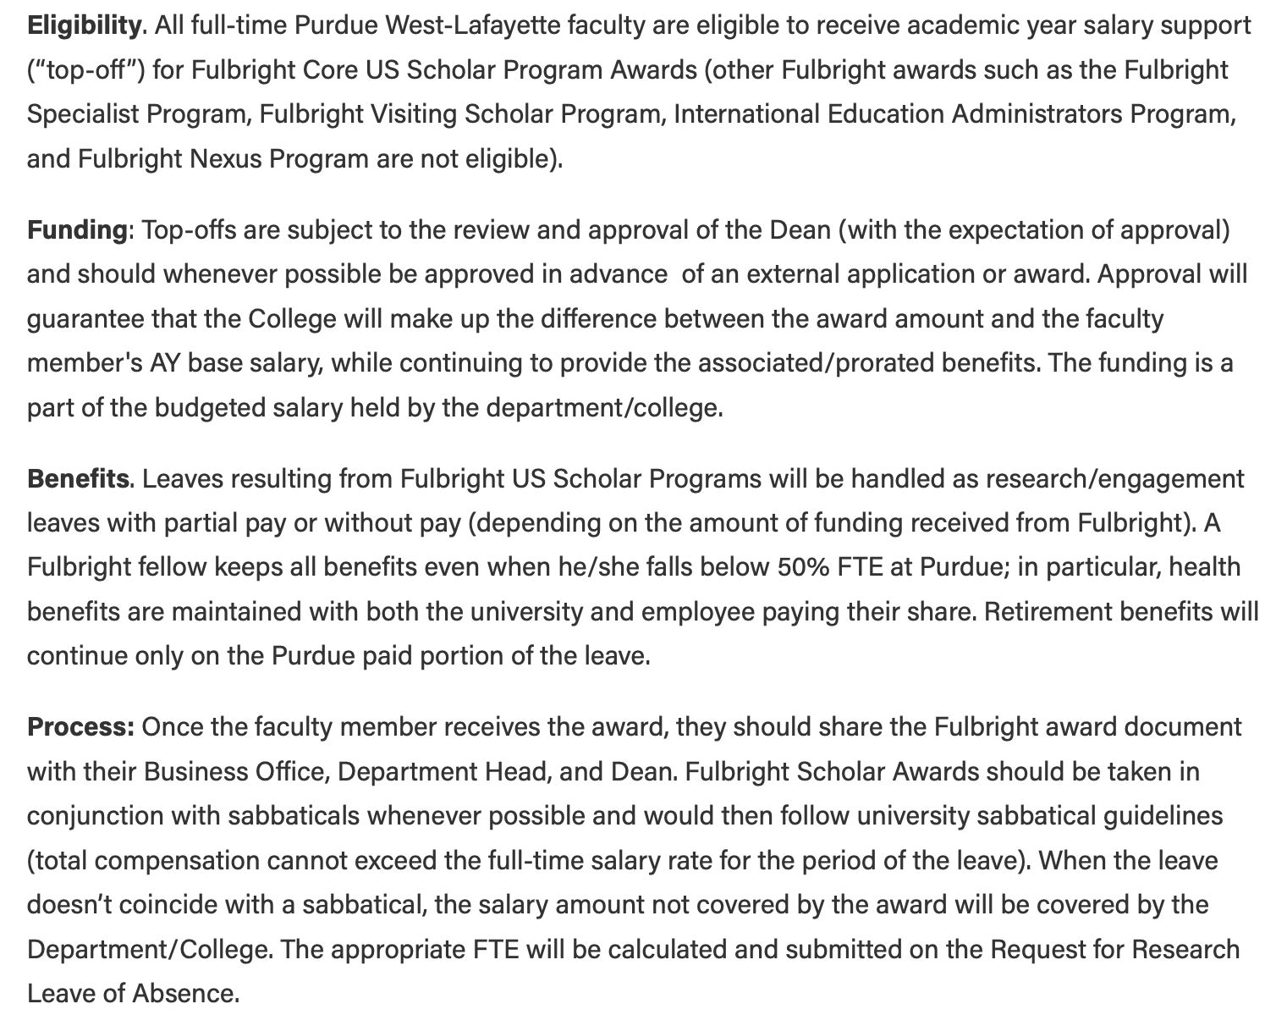
Purdue-WL Policy on Fulbright Scholar Awards
Purdue-WL’s policy can be found here: https://www.purdue.edu/provost/policies/fulbright.html

