Slide 1
PLM Best Practices Drive Value
April 2017
John MacKrell, Vice President, j.mackrell@CIMdata.com
Tel: +1.734.668.9922

Slide 2
Our Mission...
Strategic management consulting for competitive advantage in global markets
CIMdata is the leading independent global strategic management consulting and research authority focused exclusively on the PLM market.
We are dedicated to maximizing our clients’ ability to design and deliver
innovative products and services
through the application of PLM.
Notes:
Last updated: 1 January 2015

Slide 3

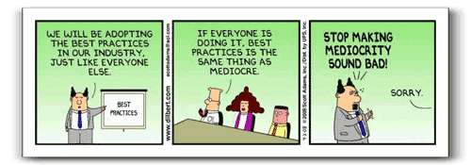
PLM Best Practices
APLM should be all about achieving business value
Employing best practices helps organizations
achieve business value from their PLM
strategies
For PLM—assure that PLM-enabling tools are both selected and implemented properly
For business processes—streamline and improve how the business operates and its ultimate success

Slide 4
PLM – CIMdata’s Definition
PLM: enabled by a product innovation platform
Strategic business approach
  NOT just technologies
  Consistent set of business solutions
Collaborative creation, use,
management & dissemination of
product related intellectual assets
  All product/plant definition information – the virtual product
    MCAD, AEC, EDA, CASE, analysis, formulas, specifications, portfolio, docs, …
  All product/plant process definitions – the virtual processes
    Processes that plan, design, produce, operate, support, decommission, recycle, …
An innovation platform that supports the extended enterprise
Spans full product/plant lifecycle, from concept through life
Requirements interface layer
Modeling & Simulation Platform
Modeling & Simulation Platform
Multi-Disciplinary Lifecycle Optimization
Data & Process Management Backbone
Data & Process Management Backbone
Notes:
Last updated: 1 July 2013

Slide 5










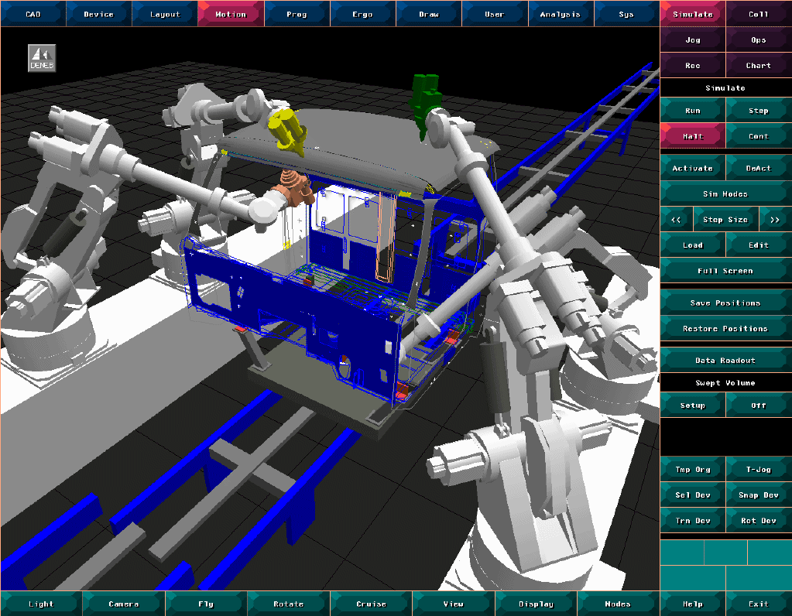
PLM Spans the Product Life
PLM touches all phases of a product’s life across the entire value chain
Conceptual Design
Product Engineering
Portfolio
Management
Planning
Manufacturing Engineering
Requirements
Simulation & Validation
Re-use
Re-purpose
Re-mfg.
Re-cover
Re-cycle
Re-tire
Disposal & Recycling
Build and Produce
Maintenance
& Repair
Test & Quality
In-service Operation
Sales & Distribution
PLM Solutions—Information Management across Media, Process, Time, Geography, & Enterprise

Slide 6
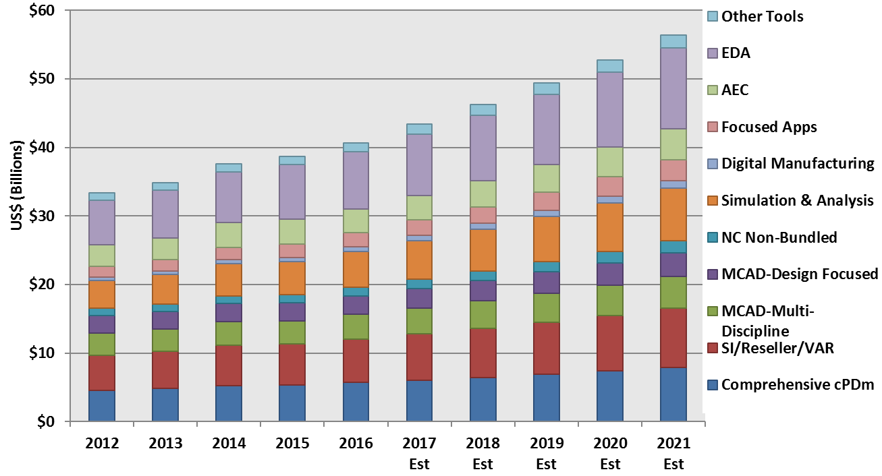
PLM Investments
Market history and forecast – software + services
Revenues presented are CIMdata estimates

Slide 7
Overall Best Practice Approach
Start with the organization’s strategy to improve business performance
Understand where the company business wants to go
Strategic business objectives
Understand what & why you do things now
Understand what you can’t control
As-is situation /
business issues
External factors /
market environment
Define a vision that supports the business drivers
Solution
drivers
Vision & structures
to improve process
Change
drivers
Define required support for your processes and organization
Requirements /
Information technology
Requirements /
Business processes
Product structure / data
Organization
Define the information technology and data requirements
Improved processes
& business control
Implement and improve

Slide 8
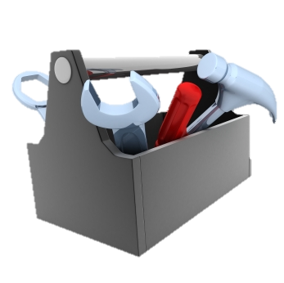
Best Practice Evaluation Tools
Evaluate potential PLM solutions with respect to how they support business
Request for Proposal/Quotation
  Indicates the solution’s technical capabilities and fit
Benchmark/Proof of Concept
  Measures the product’s technical capabilities
  Measures the solution provider’s performance and their ability to meet specific key requirements
Solution Provider Profile
  Measures the solution provider’s business health and stability
Solution Provider Partnership Potential
  Measures solution provider’s capabilities verses your critical success factors
Customer Visits
  Do they have good references in our industry?
Total Cost of Ownership
  Measures the cost of ownership over an extended period of time

Slide 9
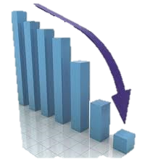
Top 10 Reasons PLM Projects Fail
Ensuring that your program manages against these is critical
Inadequately trained and/or inexperienced project managers
Failure to set and manage expectations
Poor leadership at one or more levels of the organization
Failure to adequately identify, document & track requirements
Misalignment between the project team and the business
Cultural and organizational misalignment
Poor plans and planning processes
Inadequate or misused methods
Inadequate communication
Poor effort estimation

Slide 10
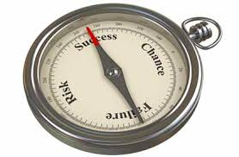
Solving the Top 10 Reasons Projects Fail
Most can be eliminated by following these good project mgt. practices (1 of 2)
Base PLM on business needs
  Support the whole business
Educate (as well as train)
Obtain committed leadership—lack of
management involvement is the main
reason PLM projects fail
  Organize the program with a Steering Committee
Harness project management skills
  Apply discipline through a proven methodology
Spend time planning, then executing each phase
  Set up the program team activities to address known problem areas PLM can support and help

Slide 11
Solving the Top 10 Reasons Projects Fail
Most can be eliminated by following these good project mgt. practices (2 of 2)
Make Communication a top priority in all areas of the program
  Use cultural change management to create adoption and advocates
Manage expectations
  Document and prioritize requirements for each phase of your program
  Assure change control is in place—change will happen
Assess the implementation
  Establish and measure metrics
  Manage quality
Commit to a sustainable program
  Organize your on-going support and operations teams
  Move quickly from production pilot to production

Slide 12
Critical PLM Program Structures
Main aspects of CIMdata’s PLM governance related best practices
PLM Center of Excellence (CoE)
  A business-oriented group comprised of business as well as IT support individuals
  The program management office and steering committee are the main groups within the center
PLM Program Decision Authority
  A PLM Steering Committee and Core Team would be responsible for providing advice to and seeking consent from the decision authority structure
PLM Organizational Change
  A network model for communication and education
  Constructed to manage and foster adoption throughout the organization
  Enables a sequence of persuasion for adoption of PLM solution
Notes:
NOTE: Cultural change is covered later

Slide 13
Executive Sponsor
Steering Committee
Business Area Executives
Business Process Owners
PLM Champion
PLM Champions
Supply Chain
SMEs/
Key Users
Stream Business Leads
Program Mgr
Strategic
Advisor
Core Team
Business Area Leaders
Client Partner
Deputy PM
Program Mgr
Chief Architect
Quality Assurance Manager
IT Project Manager
Stream Project Manager
Stream Project Manager
Enterprise Architect
Stream Bus Lead
PLM Backbone
Stream Bus Lead
Level 1
Key:
Master Data Architect
Company
PLM PMO
Stream Bus Lead
Level 2
Business Process Lead
Company
Bus Areas
Data Migration/
Integration Lead
Stream Bus Lead
Level 3
PLM Solution
Provider
Training Lead
Strategic
Advisor
Deployment Lead
Joint Steering Committee
Cultural Change Mgt Lead

Slide 14
PLM Platforms
Emerging to provide extensible, cross-domain capabilities
Monolithic enterprise information technology applications are no longer sustainable and robust enough to enable PLM
  The complexity of extended enterprise processes, organizational requirements, and information constructs cannot be addressed by any single solution or solution provider
Platforms are the foundation upon which functional capabilities, data, and processes are enabled
Platforms supports integrated solutions from multiple providers deployed on an architecture that withstands change
They provide extended enterprise enablement

Slide 15
Implementation Best Practices
Guidelines (1 of 2)
Plan ahead—create a roadmap
  Do the implementation in phases, not ad-hoc
Customize ONLY when supporting a
documented business need
  Develop a strategy that takes into account benefits verses total cost of ownership
Use business processes to drive priorities for specific integrations
  Use 80-20 rule when defining what is really required
  Ensure integrations are transparent to users
Establish the standards you are going to use and then use them consistently

Slide 16

Implementation Best Practices
Guidelines (2 of 2)
Leverage commercial services providers—don’t do it all yourself—implementing PLM is not your business
Establish reasonable & appropriate security mechanisms when communicating across enterprise boundaries
Clean and migrate data before users need it
  Data migration is mostly underestimated
Educate about PLM’s capabilities and benefits—
how and why it is good for the business
Train, train, re-train

Slide 17
PLM & Business
Best practices to support business success
Implement PLM across the enterprise—not in departments
Support whole product lifecycles well beyond product design (packaging, labeling, installation, MRO, redesign…)
Conceptual Design
Product Engineering
Portfolio
Management
Planning
Manufacturing Engineering
Requirements
Simulation & Validation
Re-use
Re-purpose
Re-mfg.
Re-cover
Re-cycle
Re-tire
Disposal & Recycling
Build and Produce
Maintenance
& Repair
Sales & Distribution
Test & Quality
In-service Operation

Slide 18

PLM & Business
Best practices to support business success
Use PLM as an innovation engine,
providing use and reuse of the
organization’s intellectual assets
Manage data intensive processes—manage all processes
  It is not just a data manager

Slide 19
PLM Provides a Single Source of Truth: E-to-E
A single source for multiple structures (e.g., multiple BOMs)—enabling the Digital Thread
Flexibily manage product configurations that have become critical to today’s demand for massive customization
Plan
Concept
Validate
Service
Design
Production
Requirements Structure
System/Logical Structure
Engineering Structure
Simulation/Testing Structure
MFG Structure
As-Supported Structure
Production Systems
(ERP/MES)

Slide 20
PLM Empowers Businesses
Enabling product innovation and enhancing performance
Provides an integrated collaborative environment for the entire product lifecycle
Increases company flexibility and agility to respond swiftly to the market
  Enables more innovation of all types
  Improves costs, quality, time to market, & ROI
  Improves relationships with customers, suppliers, partners
Utilizes valid technology, methods, and processes
  Adapts to today’s rapidly changing business environments
  Impacts the company’s bottom line

Slide 21
Expenditure vs. Committed Cost Profile
Lifecycle cost is determined by early decisions
100
100%
≈85%
% Cost Committed
80
≈70%
60
% of Projected Funds
40
% Spent (Lifecycle)
AR ≈40%
SCR = System Concept Review
PDR = Preliminary Design Review
AR = Acceptance Review
20
≈4%
SCR ≈1%
PDR ≈10%
0
Study
Implementation
Operations
Disposal
Adapted from: Forsberg, Mooz and Cotterman,
“Visualizing Project Management”

Slide 22
Benefits for Business Process
Enable product reviews—resolve problems earlier
Exploring
more
ideas
yields
innovation
Low Cost
ECs
High Cost
ECs
Less down-stream rework
High Probability of EC
on critical path
No. of Changes
Line
Stops,
TTM
Delay
$0
$100
$1,000
$10,000
$100,000
Concept
Production
Design Process—Cost of Changes

Slide 23
Enable Generation Z
The soft rumble that is reverberating throughout the corporate world
The social-savvy workforce is here, but the corporate world is still struggling to enable workers who expect:
  Instant download of applications and data with little or no training necessary
  Everything to be accessible via the Internet and over their mobile devices
  To be always connected and most communication is done in short bursts
  To collaboratively innovate—a high level and rich form of interaction
  To be part of participatory decision making processes
  Execute global business processes, gain rapid feedback, use multi-channel and multi-media communications
  To work within groups & not by themselves with distribute leadership support
  To multi-task, always doing more than one thing at a time
How do you support this if you do not have PLM?
You don’t!

Slide 24
PLM In the Academy
Results from recent CIMdata research
Use PLM in coursework, not only for contests
As it is for businesses—PLM needs to be thought of as cross-disciplinary—it is not only a new way of drafting
Embrace the breadth of PLM from CAD to PDM to process mgmt. to additive manufacturing
Use & teach PLM processes,
not just the technical tools
such as CAD
Prepare tomorrow’s leaders
to embrace PLM as a business
facilitator—Industry 4.0…

Slide 25

Concluding Remarks
PLM best practices
Focus on the impact to the business
Ensure that business processes are supported
Use a governance structure—assure management remains involved
Use proven project management strategies
Clearly articulate plans and requirements at all stages
Assess if the expected returns from PLM are viable
Scope the PLM initiative at each stage of its evolution
Communicate the objectives and progress of the PLM project

Slide 26
CIMdata
Strategic consulting for competitive advantage in global markets
World Headquarters
3909 Research Park Drive
Ann Arbor, MI 48108 USA
Tel:+1.734.668.9922
Fax:+1.734.668.1957
Main Office - Europe
Oogststraat 20
6004 CV Weert, NL
Tel:+31 (0) 495.533.666
Main Office - Asia-Pacific
Takegahana-Nishimachi 310-31
Matsudo, Chiba 271-0071 JAPAN
Tel: +81.47.361.5850
Fax: +81.47.362.0472
www.CIMdata.com
Serving clients from offices in North America, Europe, and Asia-Pacific
Notes:
Last updated: 1 July 2013

